Slide 1
Creating your own web server
By: Suraj Choudhary
Unrestricted

Slide 2
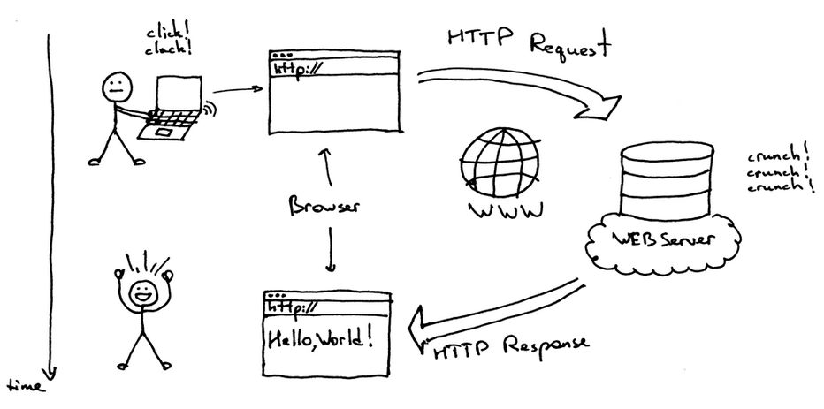
Introduction to Webserver
A Web server is a program that uses HTTP (Hypertext Transfer Protocol) to serve the files that form Web pages to users, in response to their requests, which are forwarded by their computers' HTTP clients.

Slide 3

NodeJS
Node.js is an open-source, cross-platform JavaScript run-time environment that executes JavaScript code outside of a browser.
Node.js lets developers use JavaScript to write command line tools and for server-side scripting—running scripts server-side to produce dynamic web page content before the page is sent to the user's web browser.

Slide 4
NodeJS Vs Others
Fast Server-Side Solution
One Language Across the Stack
Flexibility
Non-blocking I/O
Event driven
Modern, less legacy code encumbered
You are responsible for everything

Slide 5
Lets Get started…
Write a program to Print Hello World on console.
Print number/Date and time in incremental order after every one second.
Print message after 5 seconds on screen.
JavaScript objects
JavaScript JSON
JS == and ===
require

Slide 6
Create your WEB Server
var http = require('http'); //create a server object: http.createServer(function (req, res) { res.write('Hello World!'); //write a response to the client res.end(); //end the response }).listen(8080); //the server object listens on port 8080

